Slide 1
CZ4041 MACHINE LEARNING PROJECT
Store Item Demand Forecasting Kaggle Challenge

Slide 2
OUR TEAM
TEKWANI PUNEET
NIKHITA MENON
FAZILI NUMAIR
ARORA MANAV
RAJURAVI VISHAL RAJ
U1722127D
U1722287L
U1822056F
U1822077D
U1822268B

Slide 3
AGENDA
Problem Description
Preprocessing the Data
Models
Conclusion
Understanding the Data
Analyzing the data
Kaggle Score & Rank

Slide 4
01
PROBLEM DESCRIPTION

Slide 5
Problem Statement
Given
Forecast
5 years of store item sales data from (2013 - 2017)
3 months of sales for 50 different items at 10 different stores

Slide 6
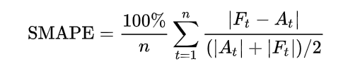
Evaluation
Symmetric Mean Absolute Percentage Error (SMAPE or sMAPE) accuracy metric
Based on percentage errors or relative errors

Slide 7
02
UNDERSTANDING THE DATA

Slide 8
train.csv
DATA | DESCRIPTION
date | The transaction date of the specified item at the specified store, ranging from 1/1/2013 to 31/12/2017
store | Unique numeral store identifier (1-10)
item | Unique numeral item identifier (1-50)
sales | Turnover of the specified item at the specified store on the specified date

Slide 9
test.csv
DATA | DESCRIPTION
id | Unique numeric identifier for a specific date, store and item
date | Transaction date of the specified item at the specified store, ranging from 1/1/2018 to 31/03/2018
store | Unique numeral store identifier (1-10)
item | Unique numeral store identifier (1-50)

Slide 10
03
PREPROCESSING THE DATA

Slide 11
Preprocessing the data
Data Wrangling : The dataset provided does not contain any null, duplicate or undefined values.
Feature Engineering : The project is based on a time-series problem and thus, we decomposed the ‘date’ data field into the following components. These derived features will allow us to effectively capture the seasonality patterns.
Day
Day of the week
Day of the year
Week of the year
Month
Year

Slide 12
 | MIN | MAX | MEAN | STANDARD DEVIATION
date | 2013-01-01 | 2017-31-12 | N/A | N/A
store | 1 | 10 | N/A | N/A
item | 1 | 50 | N/A | N/A
sales | 0 | 231 | 52.3 | 28.8
‘store’ and ‘item’ data attributes are classified as categorical data types.

Slide 13
04
ANALYZING THE DATASET

Slide 14
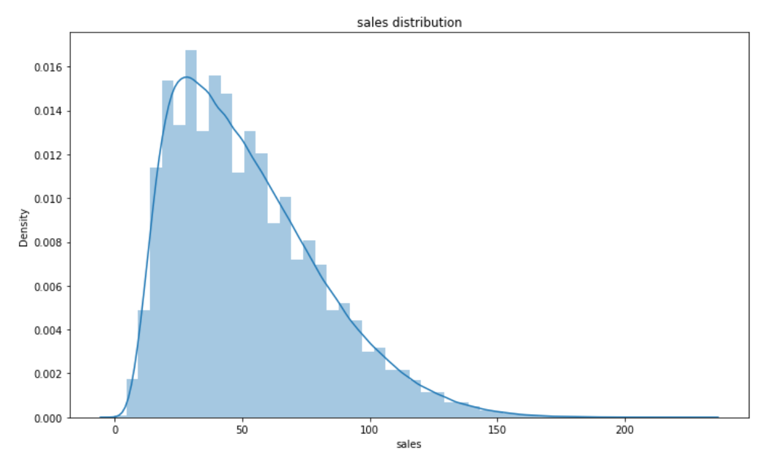
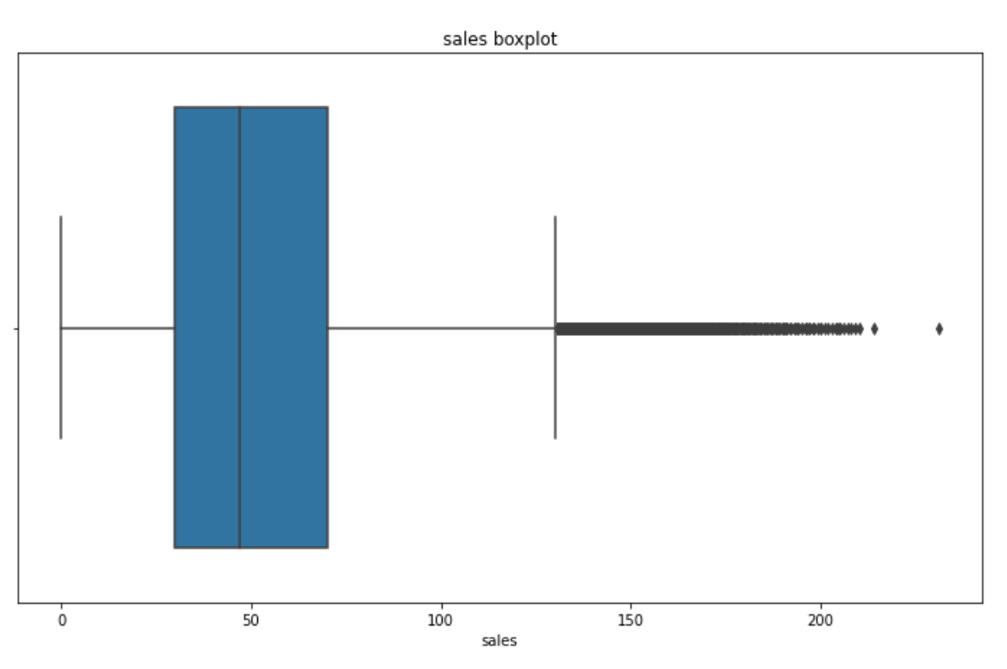
Sales Distribution
Sales Distribution
Sales Boxplot

Slide 15
Sales Distribution (cont’d)
Right skewed normal distribution with
Mean = 52.25
Median = 47
Mode = 30
Indicates that overall sales are dominated by extremely high values
Values greater than 200 account for 0.001% of total sales of Store 2
Hence classified as outliers and eliminated from the dataset

Slide 16
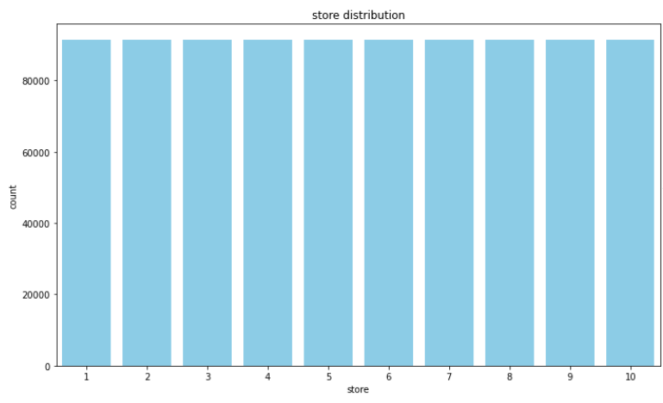
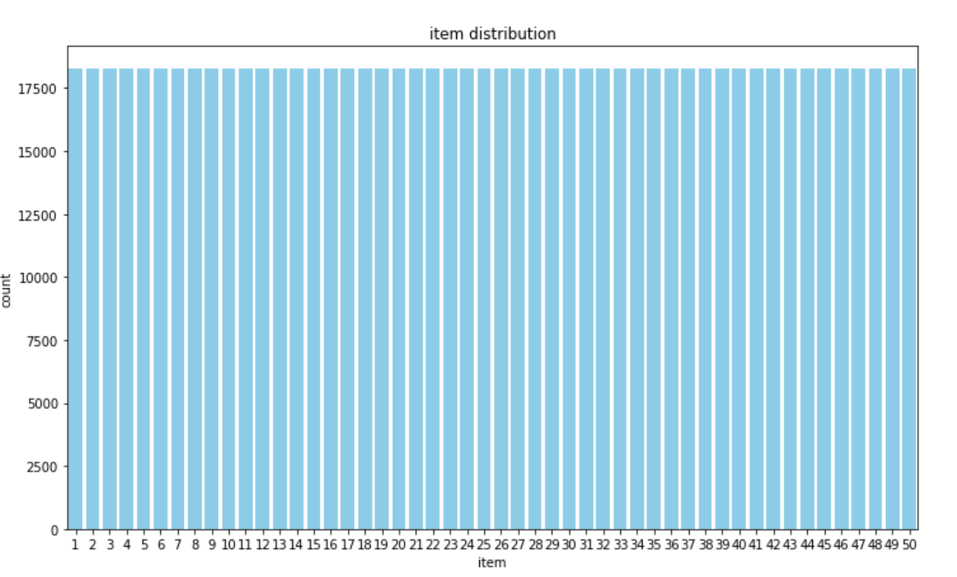
Store & Item Distribution
Store Distribution
Item Distribution

Slide 17
Store & Item Distribution (cont’d)
Follow a uniform pattern and are equally distributed
Allows us to weigh each store equally without including any logic for class imbalancing

Slide 18
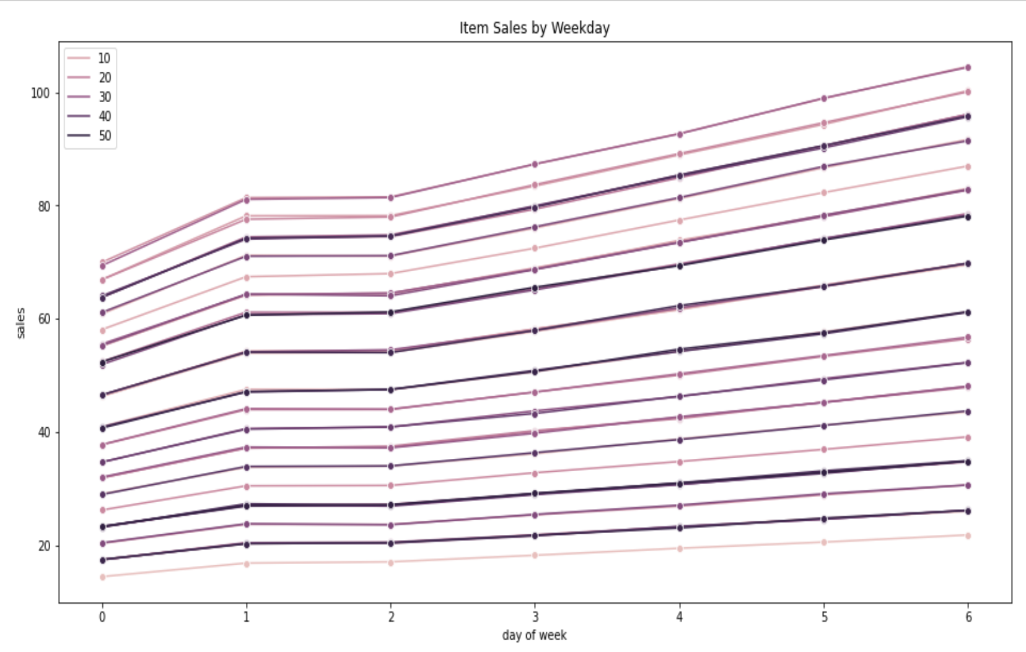
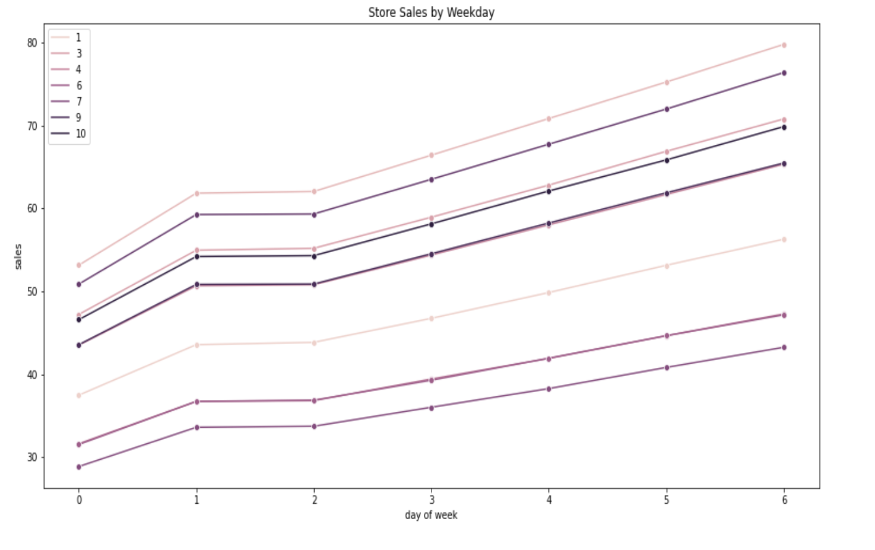
Daily Trends
Daily Sales for all Stores across the Week
Daily Sales for each Store across the Week

Slide 19
Daily Trends (cont’d)
Mostly upward trend across the week
Peak of sales on Sunday
Store 7 has the highest sales….
Store 3 has the lowest sales….
Several factors could affect the sales of a store including:
Proximity of the store to residential areas
Quality of Service -> Customer Satisfaction
Promotions available at the Store (and several others….)

Slide 20
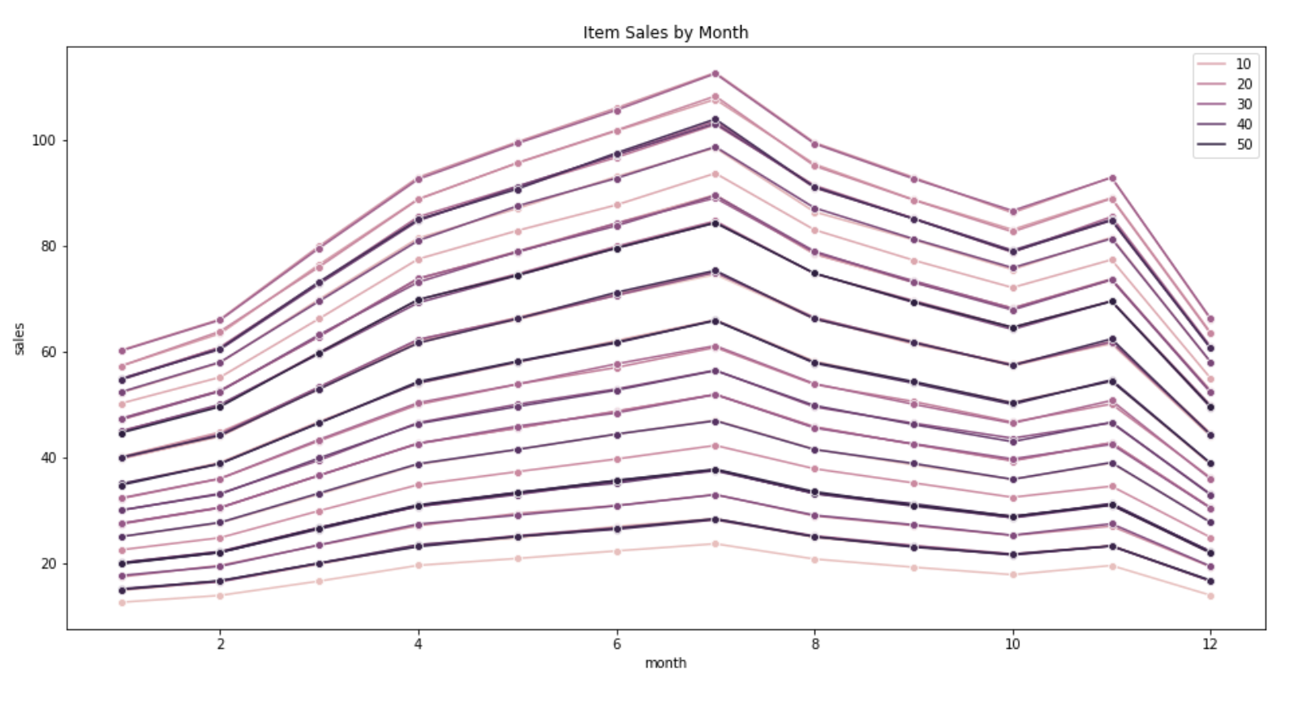
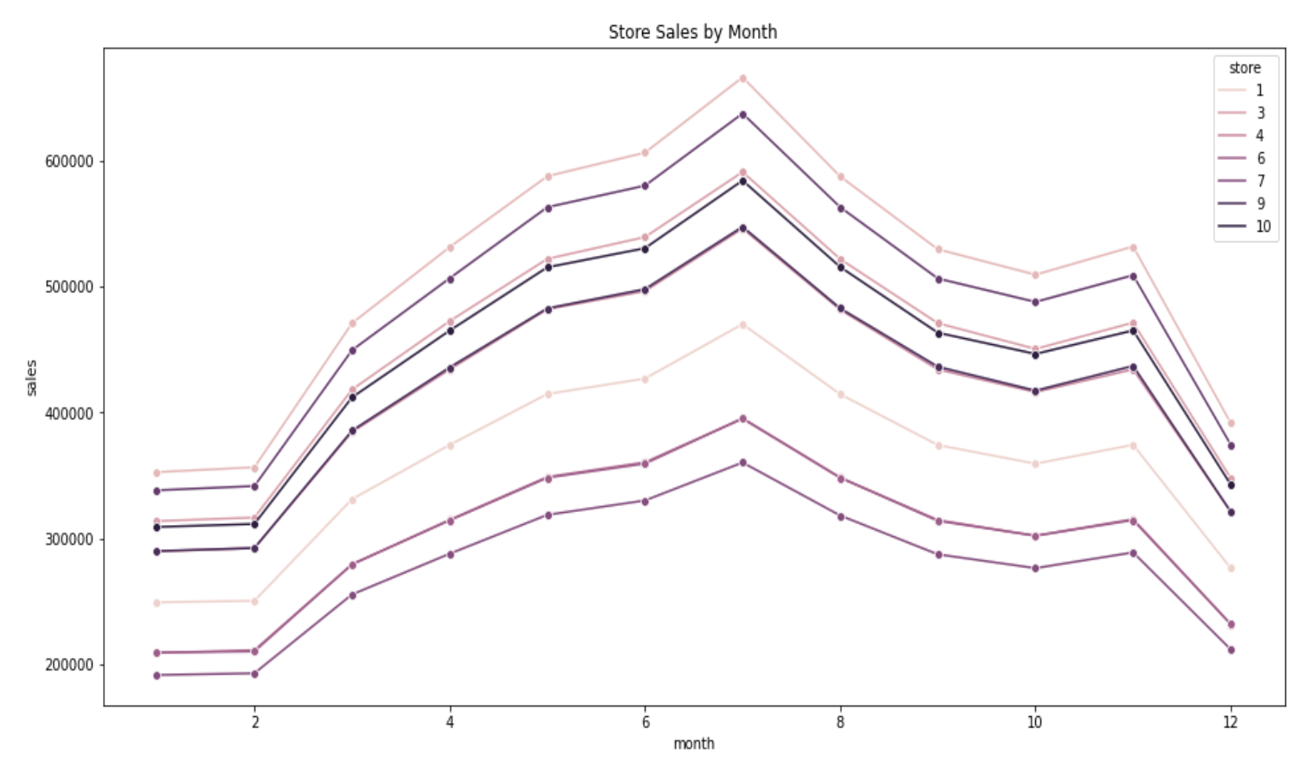
Monthly Trends
Monthly Sales for all Stores across the Year
Monthly Sales for each Store across the Year

Slide 21
Monthly Trends (cont’d)
Fluctuation in sales levels over the months of the year
More or less consistent upward trend from January to July
Decline from July to October
Rise in November
Sharp decline in December
Fluctuations could be caused by factors such as holiday period in July and travel season in December
Store-wise differences in sales are similar to daily trends.

Slide 22
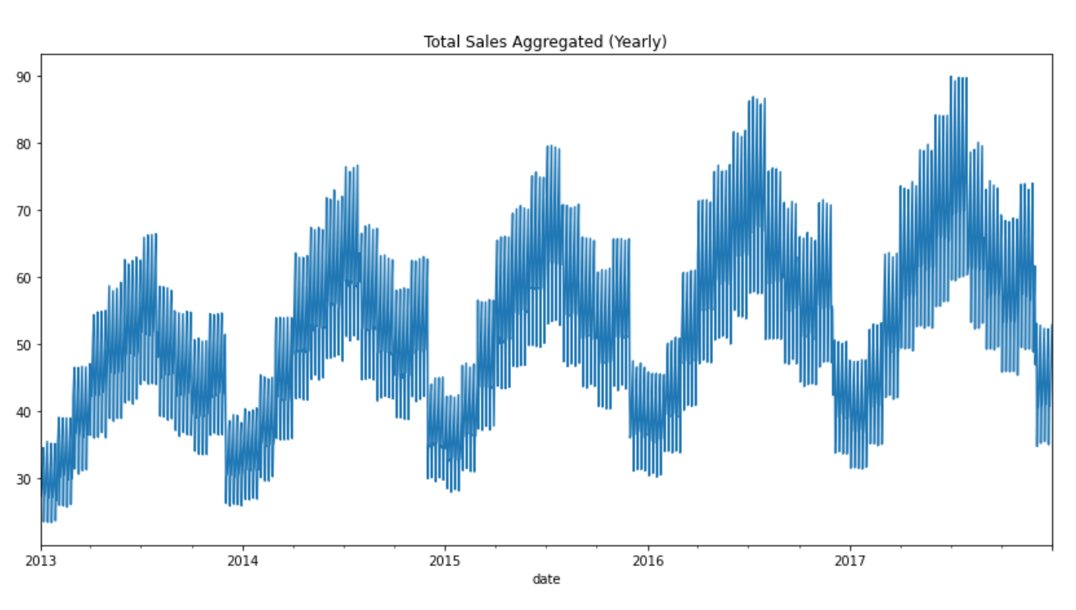
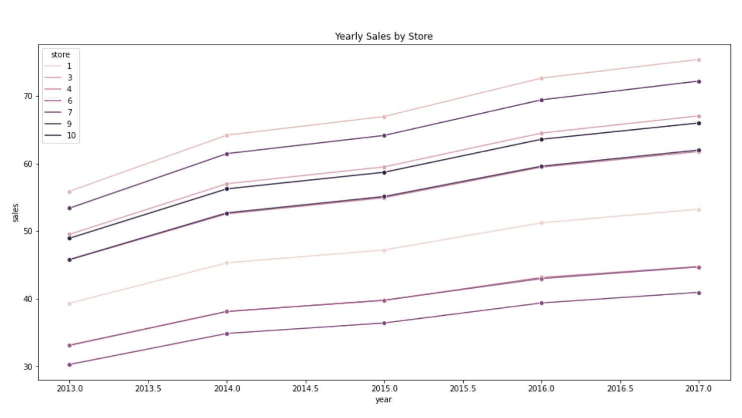
Yearly Trends
Yearly Sales for all Stores (2013 - 2017)
Yearly Sales for each Store (2013 - 2017)

Slide 23
Yearly Trends (cont’d)
Fluctuating sales over each year
Starts off with a rise in sales volume until mid-year, followed by a decline
Standard pattern of fluctuations (rise and fall) in sales every year
Increase in sales volume with every year
Increase in demand of items
Inflation
Higher standard of living
(and several others….)

Slide 24
Overall Observations from Data Analysis
Consistent seasonal patterns without any aberrations
Stable weekly, monthly and yearly seasonal patterns for every store-item combination
Seasonal sales for all item/store combinations follow the same pattern and therefore prediction of one combination allows us to predict the others as well

Slide 25
MODELS
05

Slide 26
LightGBM
Gradient boosting framework which uses tree based learning algorithm.
Leaf-wise growth algorithm reduces loss which makes it one of the best performing models in Kaggle competitions.
Motivation :
Handles large size of data & taking lower memory to run.
Focuses on accuracy of results
Used for Ranking & Classification
Performance and Scalability
Boost weak learners to strong learners
Importance to instances that are misclassified

Slide 27
Preprocessing
01
02
03
04
Removal of increasing trend and yearly seasonality from the sales values. Normalisation of the stationary sales values and identification of the outliers
Find slope and intercept of a linear fit for sales values grouped by store, item and day of week. Thereby, fitting a linear model to the sales value.
Handling the outliers using interpolation to get corrected sales and building the expanding mean sales values grouped by store, item, (day of week, month, and quarter).
Finding stores and items whose mean sales value is below the 50% percentile. The prediction for year 2018,the items of these store will be multiplied by a factor smaller than one.

Slide 28
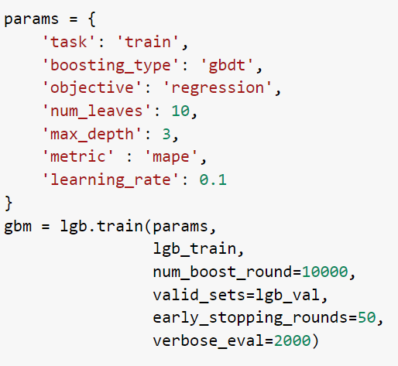
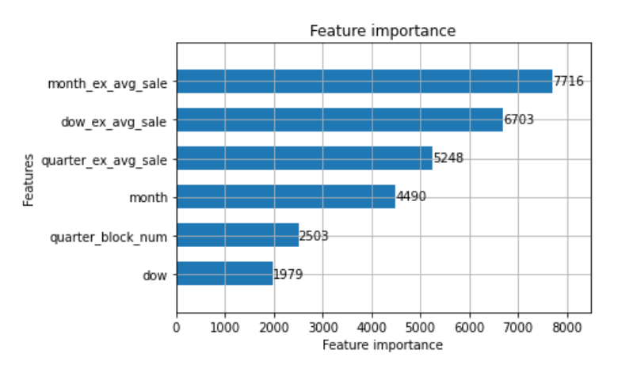
LightGBM
Investigate Feature Importance
Parameters & Hyper-Parameters for 2018 Prediction

Slide 29
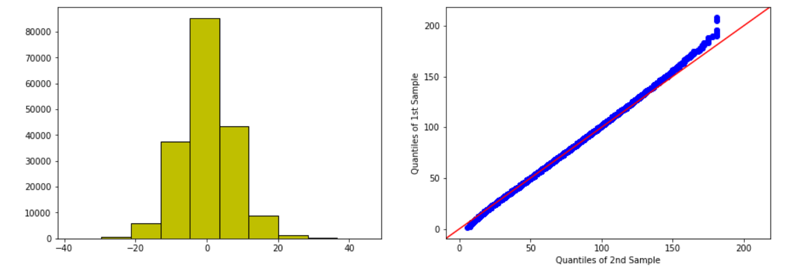
Error Distribution and Analysis
Validation SMAPE : 12.596475638871734

Slide 30
LightGBM Prediction Score
13.94421
12.67741
12.59647
Validation Score
Public Leaderboard
Private Leaderboard

Slide 31
Analytical solution
Mathematical representation of the existing system to predict future sales without solving any optimization problem.
Motivation
Presence of synthetic data with consistent patterns and discussion threads on Kaggle.
Methodology
Iteratively explore different configurations to find the best solution with lowest SMAPE score.

Slide 32
FINAL MODEL
Feature Selection
Model representation
Terminology
Store, item, dayoftheweek, month, year
Predicted sales = sales(store,item) * salesFactor(month) * salesFactor(dayofweek) * growth(year)
Sales factor defined as column aggregation / mean of the data
Annual growth computed using second degree polynomial regression

Slide 33
06
KAGGLE SCORE AND RANK

Slide 34
Leaderboard
12.60191
13.87764
Private Leaderboard
Public Leaderboard
Best position (private leaderboard)
23rd/459

Slide 35
CONCLUSION
07

Slide 36
CONCLUSION - LEARNINGS
Frameworks Learning how to decompose machine learning related tasks effectively with minimal overlap, while sticking to schedule
Communication Communicating effectively and regularly between EDA and Modelling teams increased the efficiency and quality of our work
Model Tuning Learn the process of model tuning through trial and error, to find the best configuration for our analytical model

Slide 37
CONCLUSION - SUMMARY
This project provided us with the opportunity to:
Put into practice, the various Machine Learning methodologies we learnt through this course
Overcome any computational bottlenecks and analytical challenges such as model tuning, and work together as a team, to effectively solve the given challenge and enter the top 5% on the leaderboard
Implement Machine Learning models for sales forecasting - a crucial process in companies today to enable informed business decisions

Slide 38
Thank You!

